Slide 1
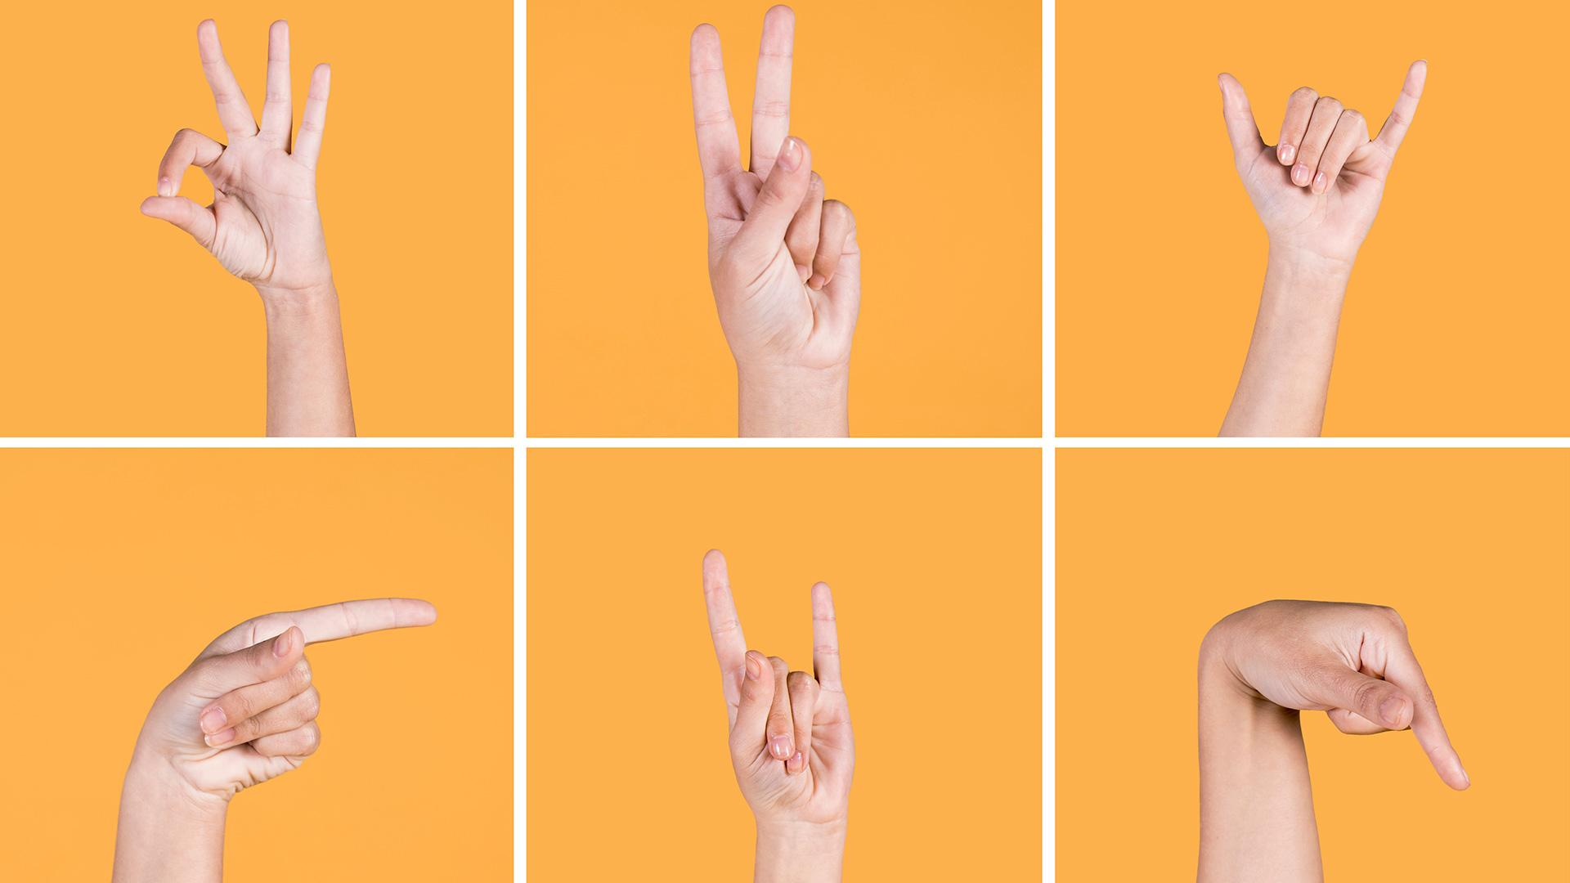
SIGN LANGUAGE TRANSLATOR
Under the Supervision of:
Dr. Mohamed Zorkany
Submitted by:
1- Ahmed Nabil Ali Elghamry
2- Ahmed Nader Goda
3- Mohamed Reda Abd Elgawad
4- Omar Mohamed Mahmoud
5- Raed Tarek Habib
6- Shimaa Ahmed Daowd

Slide 2

Sign language (SL)
Is the main means of communication between hearing-impaired people and other communities and it is expressed through manual and non-manual features.

Slide 3
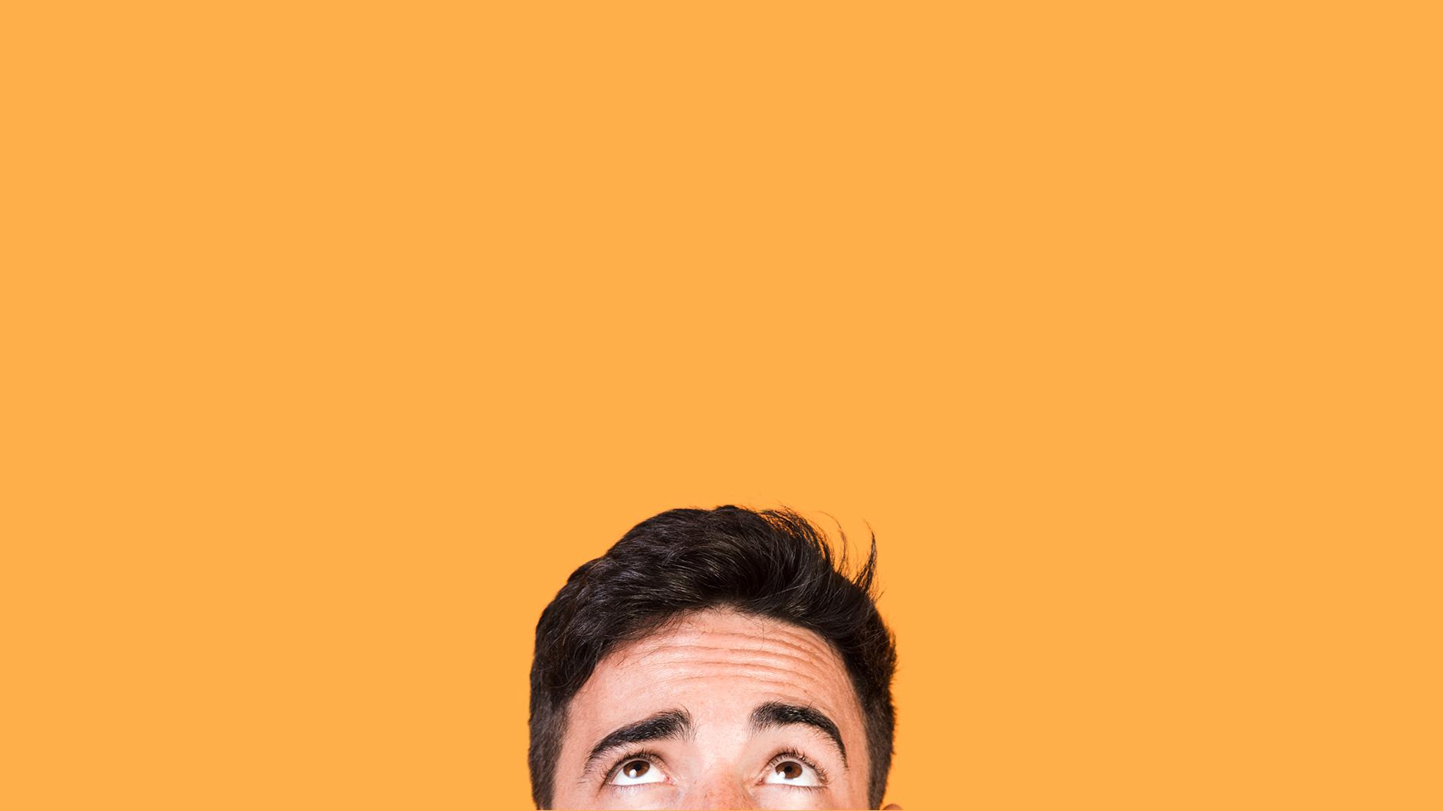
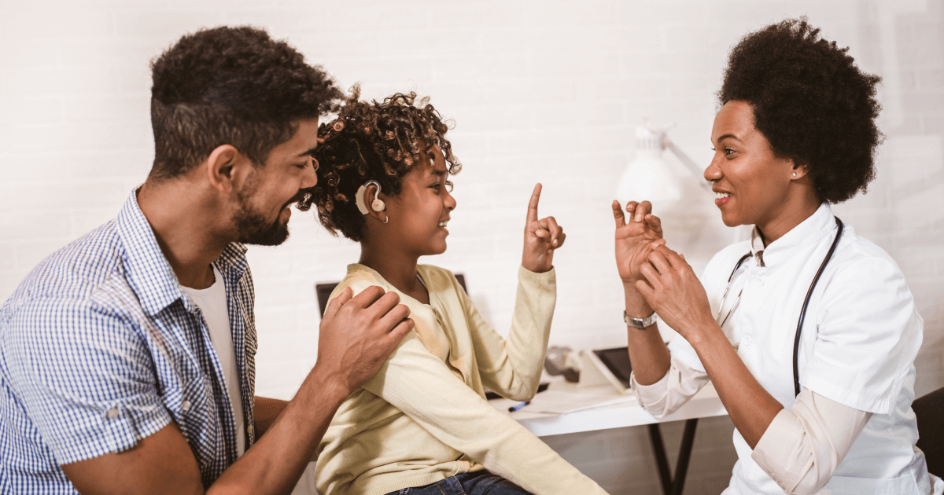
Sign Language Translation (SLT)
The translation between different sign languages, as well as the translation between sign and speaking languages. SLT methods employ sequence-based machine learning algorithms and aim to bridge the communication gap between people signing or speaking different languages

Slide 4
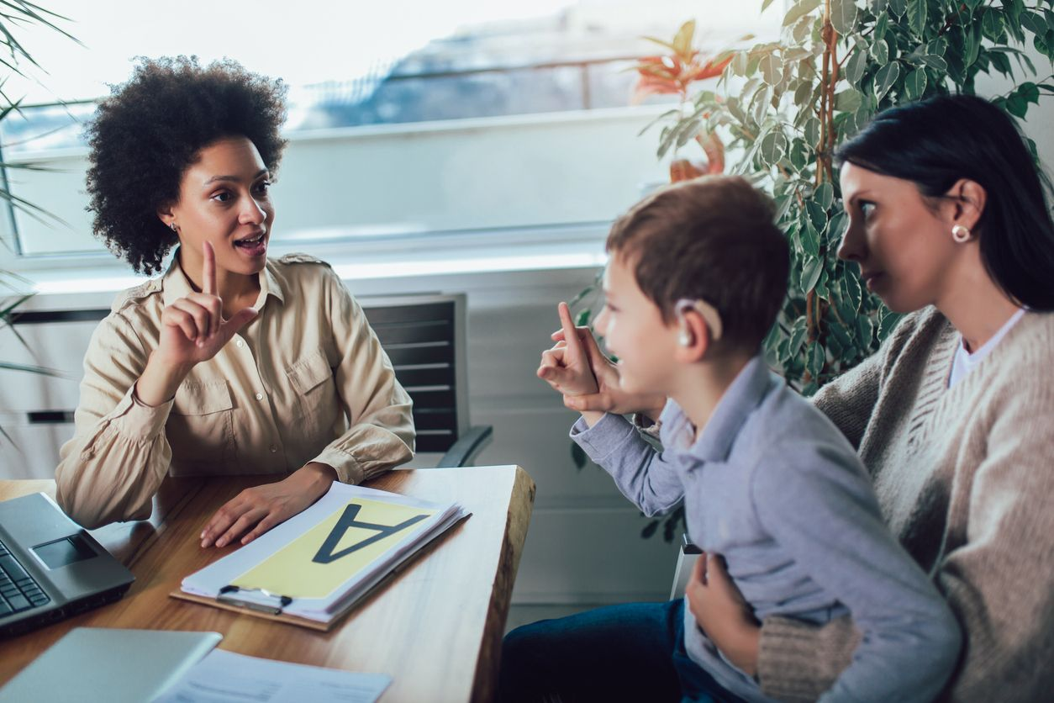
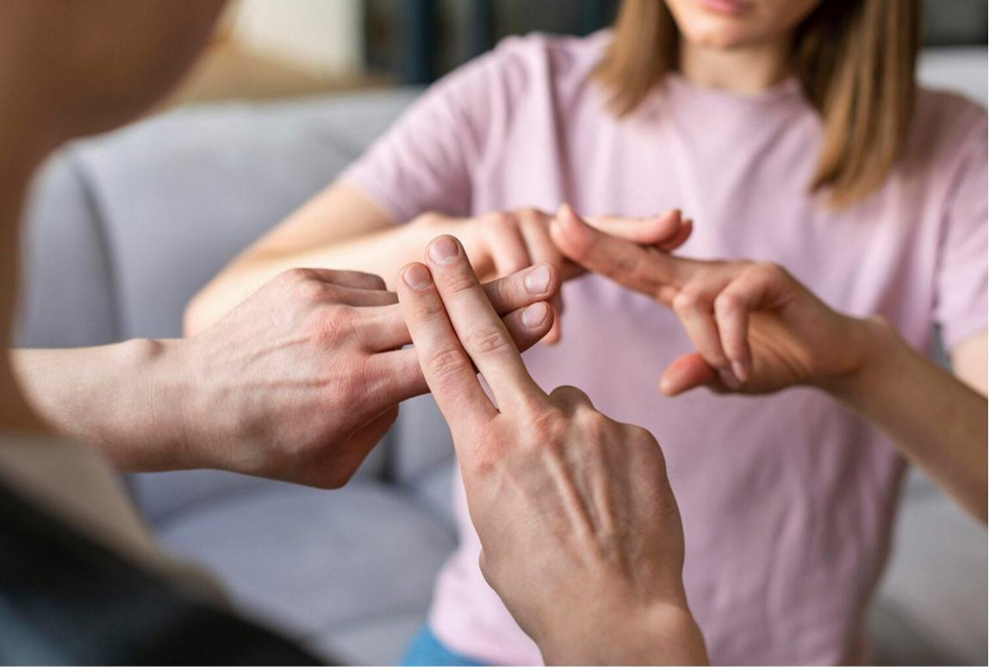
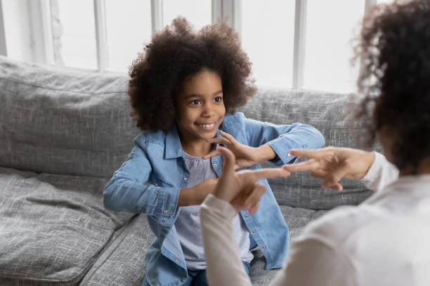
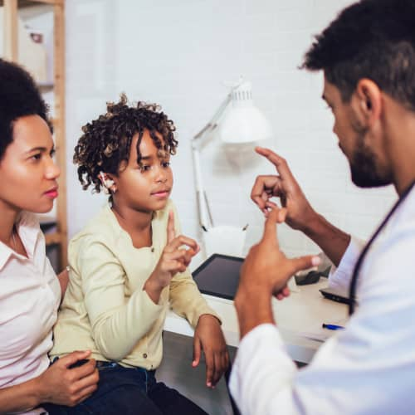

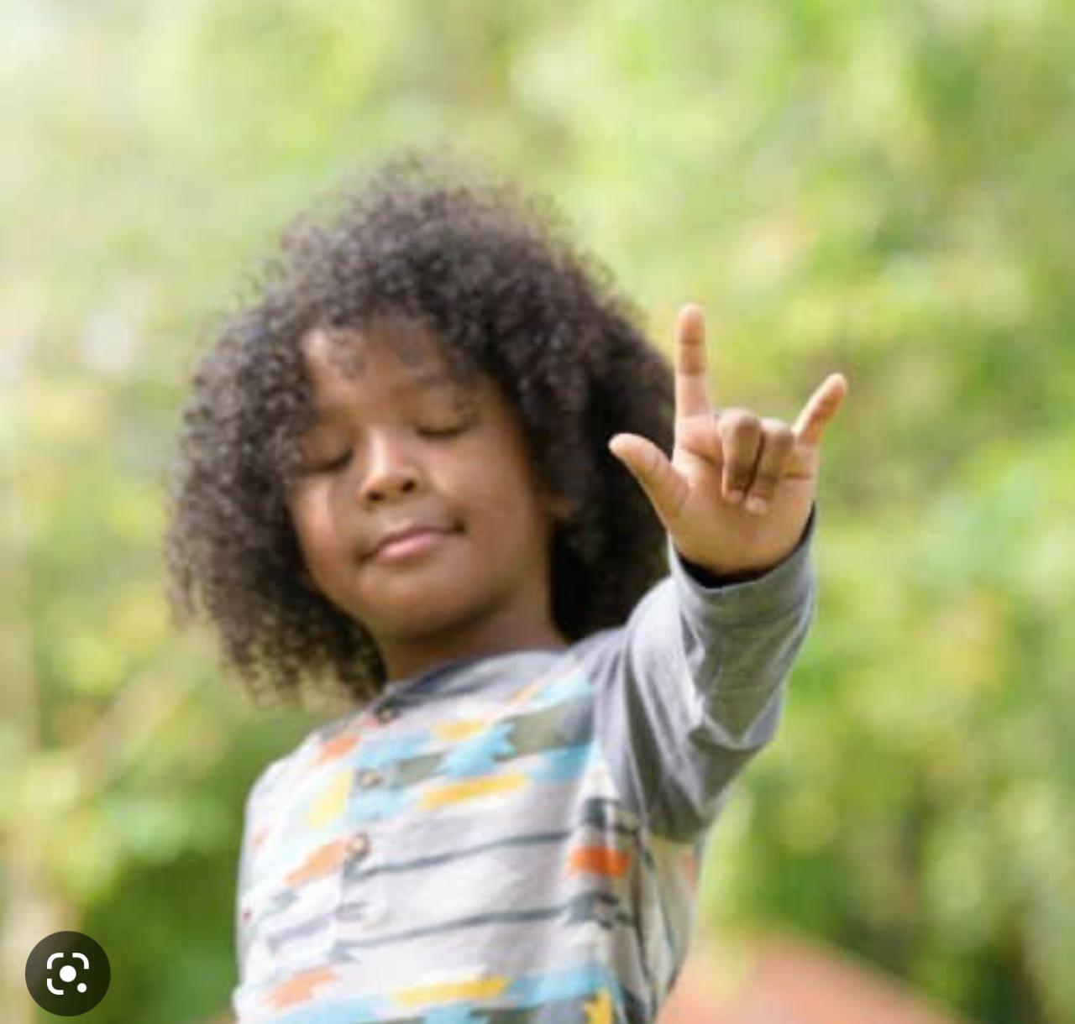

Slide 5
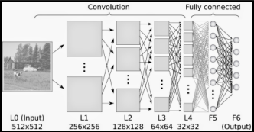
Algorithms
Convolutional Neural Network (CNN)
A convolutional neural network (CNN, or ConvNet) is a type of feed-forward artificial neural network in which the connectivity pattern between its neurons is inspired by the organization of the animal visual cortex.

Slide 6
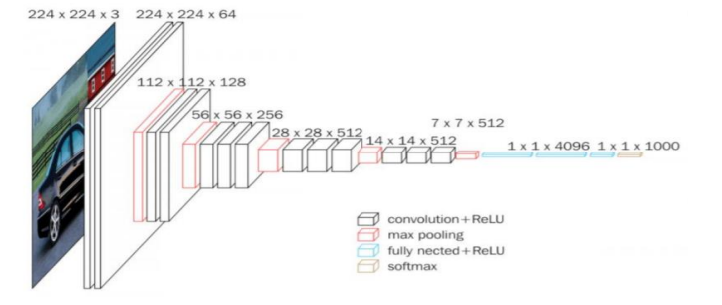
Our VGG Model
VGG- Network is a convolutional neural network model proposed by K. Simonyan and A. Zisserman in the paper “Very Deep Convolutional Networks for Large-Scale Image Recognition” [1]. This architecture achieved top-5 test accuracy of 92.7% in ImageNet, which has over 14 million images belonging to 1000 classes.

Slide 7
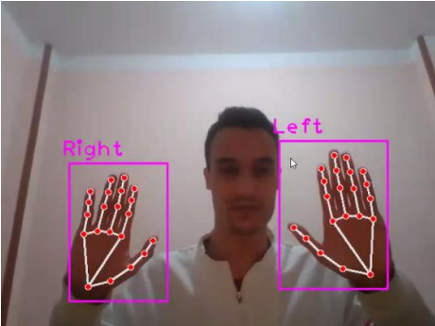
Our Approach
In our Approach we created our data set by capturing the gestures from a webcam using Open CV and the MediaPipe API to capture only the hands, then, we split our data set into train set and test set, to train the model to be able to make predictions.
Capturing and Detecting Hands
Final Image after Capturing Sign Language Gesture

Slide 8
Data Set Used
The data set used consists of American Sign Language (ASL) Gestures, with 28,967 images belonging to 30 gestures. 4 nonexpert subjects executed about 1000 repetitions of every gesture thereby producing about 1000 images per class or gesture.
Id | Name | Id | Name | Id | Name
1 | Bathroom | 13 | Mom | 25 | Monday
2 | Dad | 14 | Need | 26 | Saturday
3 | Deaf | 15 | No | 27 | Sunday
4 | Drink | 16 | Open | 28 | Thursday
5 | Eat | 17 | Please | 29 | Tuesday
6 | Goodbye | 18 | Sorry | 30 | Wednesday
7 | Hello! | 19 | Space
8 | I Love You | 20 | Telephone
9 | Like | 21 | Think
10 | Love | 22 | YES
11 | Me | 23 | You
12 | Mine | 24 | Friday

Slide 9
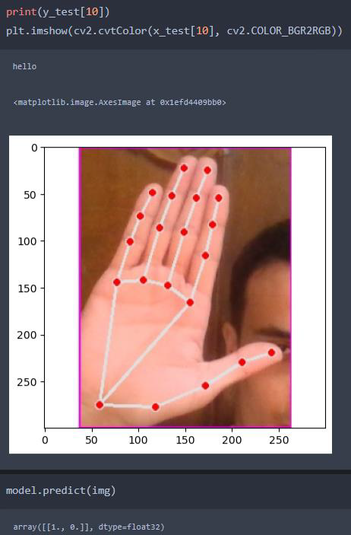
Making Predictions

Slide 10
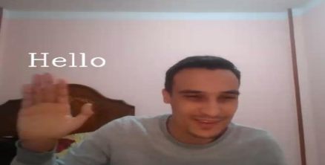
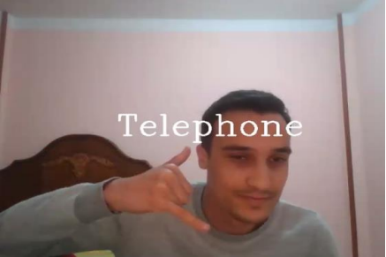
Result of First Gesture (Hello)
Results:
Result of Second Gesture (Telephone)

Slide 11
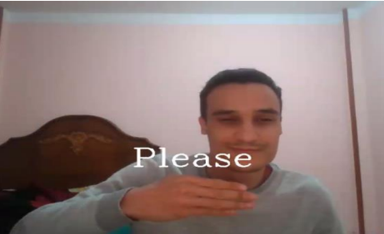
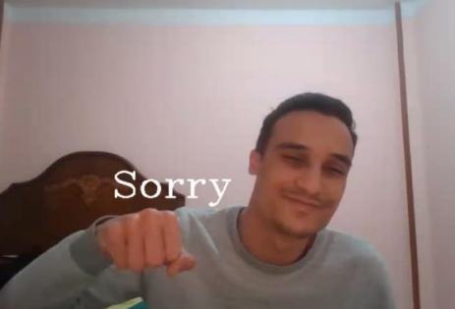
Result of Third Gesture (Please)
Result of Fourth Gesture (Sorry)

Slide 12
Conclusion and Future Work
Hand gesture recognition is a difficult problem and the current work is only a small contribution towards achieving the results needed in the field of sign language gesture recognition. This report presented a vision-based system able to interpret isolated hand gestures from the American Sign Language (ASL).
Future Work:
This project for individual gestures can also be extended recognizing continuous sign language gestures with both hands and the face using the Single Shot Multi-Box Detector.
We wish to extend our work further by expanding our data set to include almost every single word in the American Sign Language (ASL), and then deploy this project into a mobile application to be used in real life.

Slide 13
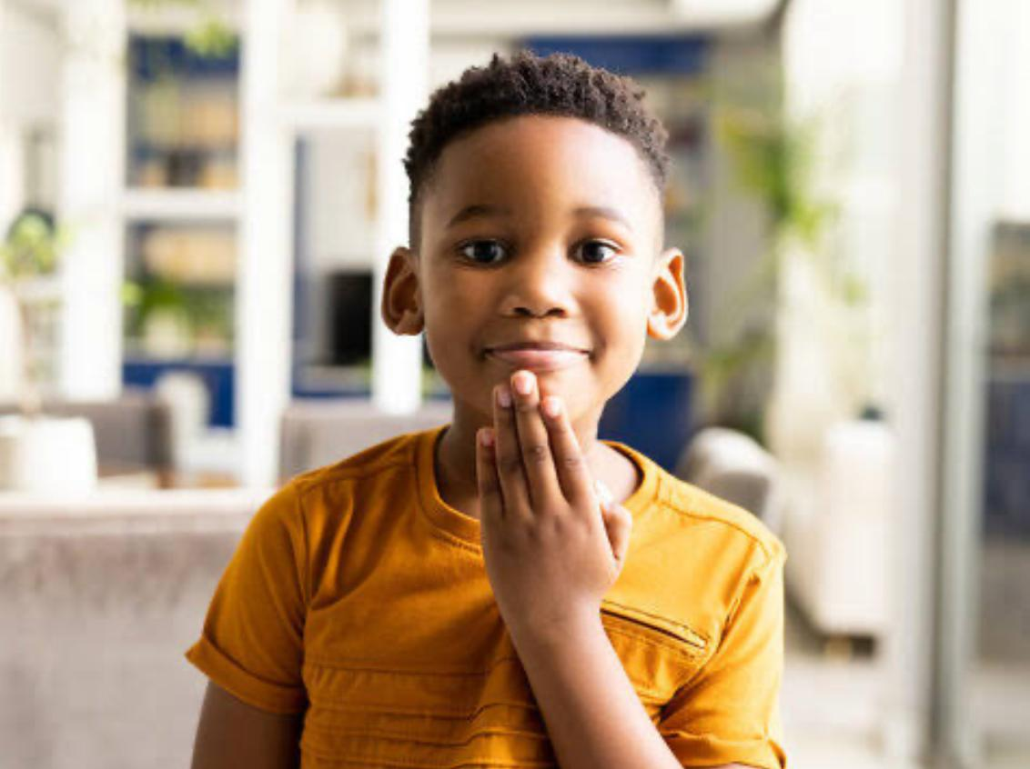
THANK YOU!

Slide 14
Contact Info:
Ahmed Nabil Ali Elghamry
Email: Dr.aelghamry@gmail.com
Mobile: 01015309152
Ahmed Nader Goda
Email: a.gouda8wo@gmail.com
Mobile: 01128804804
Mohamed Reda Abd Elgawad
Email: mohamedreda2271@gmail.com
Mobile: 01023381292
Omar Mohamed Mahmoud
Email: obadramer44@gmail.com
Mobile: 01007372795
Raed Tarek Habib
Email: raedtarek97@gmail.com
Mobile: 01068631218
Shimaa Ahmed Daowd
Email: Sh.daowd112@gmail.com
Mobile: 01009404627

